Slide 1

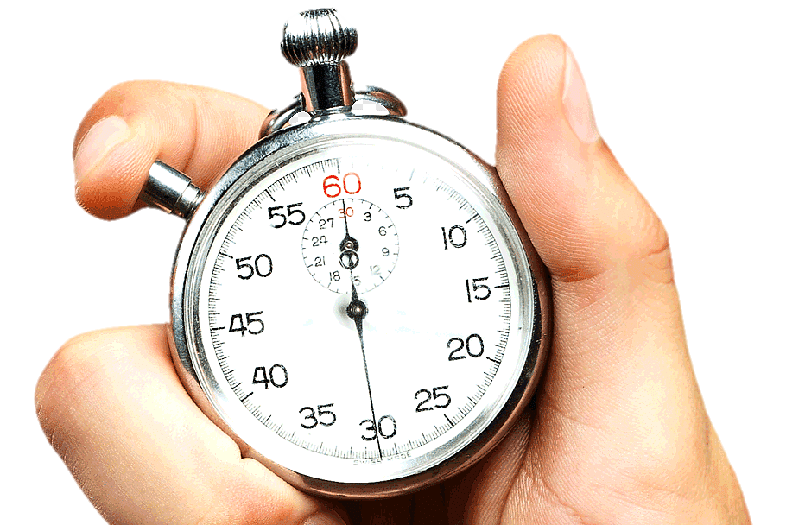
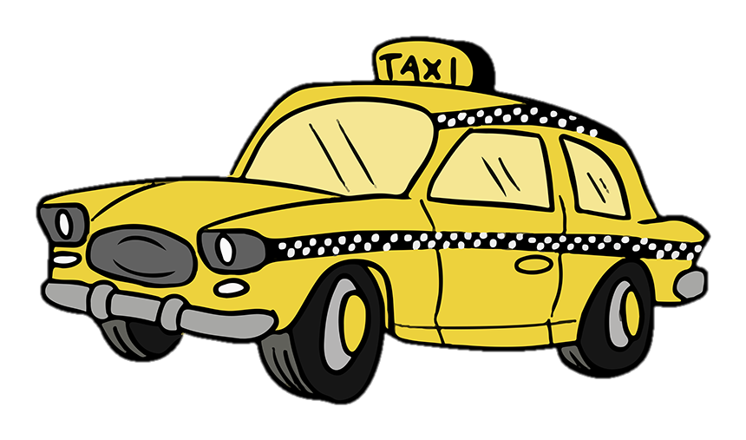
New York Taxi Trip Duration

Slide 2
New York Taxi Trip Durations
Our Main Objective is to Predict the Duration of a Taxi Trip
in the city of New York

Slide 3
Factors affecting Trip Duration
We are categorising the features into __ broad categories-
Taxi Details
Driver Details
Passenger Details
Day/Time Based Features
Demographics

Slide 4
1. Taxi Features
Condition of the Taxi – (Good or bad)
Type of Taxi – (Small or Large)
What type of taxi used for short duration (Sedan/Hatchback/SUV) ?
What type of taxi used for longer duration ?
Does smaller taxi have lesser commute time within city limits and visa versa ?
Larger taxi have fast travel time ?

Slide 5

2. Driver and Passenger Details
Age of the Driver and drivers experience affects the duration
If Passengers have any special requests (like if the passenger is Old Aged/ Pregnant/ Sick, the duration could be slow or someone would want to reach somewhere urgently in case of emergencies)
Number of passengers, cause more passengers tend to take bigger car which can take more time for within city commute
If it was a Car Pool or not? (Passengers with multiple destinations might hire the same cab.)

Slide 6

3. Day or Time based Factors
Time of the Day when the taxi is called might have a major influence on the trip duration.
Weather conditions (Rain, Hail, Snow, Extreme Heat etc.) might influence the duration of the trip.
Public Holidays may see lesser number of drivers (the waiting time could be more) but the travelling time could be less if the traffic is less.
If there is a Holiday season going on (Summers, Christmas, Thanksgiving etc.), the travelling time may be lesser

Slide 7

4. Demographics
Distance between the pick up point and drop point (Outstation rides might take more time)
Location of Pick Up point
Location of Destination point
Route taken (Highways, City Roads etc.)

Slide 8

The Dataset
Our Dataset contains the following set of variables-
id | vendor_id
pickup_datetime | dropoff_datetime
passenger_count | store_and_fwd_flag
pickup_longitude | pickup_latitude
dropoff_longitude | dropoff_latitude
trip_duration

Slide 9
Factors affecting Trip Duration
Now, we are categorising these into 4 broad categories-
Vendor Details
Passenger Details
Day/Time Based Features
Demographics
Also from the given data set we can come up new features like speed, travel distance and other date -
time parameters

Slide 10
1. Vendor Details
Which Vendor’s Taxis have the least average duration, and is there any specific reason for it and vice versa?
During which hours do Vendor 1 and 2 taxi’s function ?
Average number of Passengers per Vendor ?
Which Vendor took more long trips, and which one took more short trips (in terms of Distance) ?

Slide 11
2. Passenger Details
Count of passengers and duration. Does more passenger result in more trip time ?
Does passenger count and speed have any co-relation ?
Does distance of travel increase with passenger count ?
Number of passengers boarding at a particular pick up point ?
Number of passengers dropping off at a particular drop off point ?

Slide 12
3. Day or Time based Factors
Number of rides started in an hour or at a particular time
To check if office hours(9-6) take more time to commute.
Does early morning and late night rides have lesser duration ?
Day, Month, week & year wise analysis to find any patterns.
Weekday and week end analysis: Weekdays may have higher travel time and weekends may have lesser travel time ?
Does short duration trips span less than half an hour?
Does public holidays have lesser commute time ?
Weather conditions (Rain, Hail, Snow, Extreme Heat etc.) might influence the duration of the trip.

Slide 13
4. Demographics
Relationship between the Distance and Time taken by the ride ?
Does pick up point affect the duration ?
Does drop point affect the duration ?
If store flag is true then the trip has a long duration ?

Slide 14

Details to ask the clients
Pick up and drop Location names
Route the taxi took, if it was City Road or a High way
Type/Model of the taxi
Details about the Drivers
If the ride was a Car Pool or not?
If the ride was Inter City or Intra City?

Slide 15
THANK YOU

